Slide 1


Salma CHERAIBAT
Mohamed DAKKOURI
Salma ESSAOUI
Satnam SINGH
Jihane WADI
Automating the process of real estate market price valuation at Issy-Les-Moulineaux

Slide 2












Who we are
A highly skilled & diversified team
5 Team members
More women than men in the team ! (3vs2)
3 Nationalities represented !
+ 15 Years of cumulated work experience !
+ 10 Projects delivered !
Use data to improve your process

Slide 3

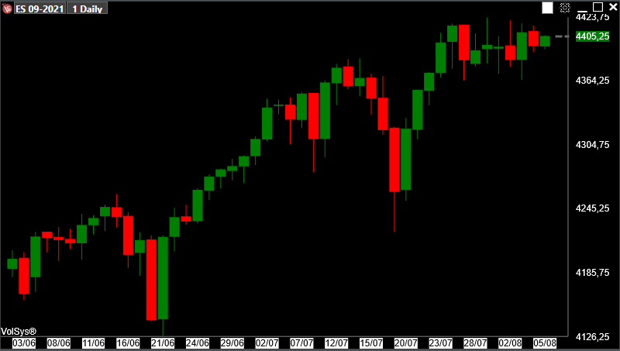
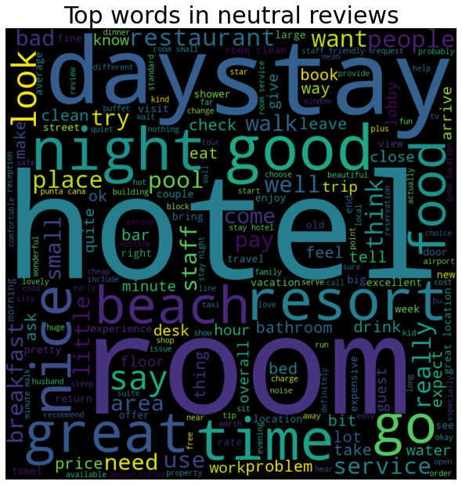
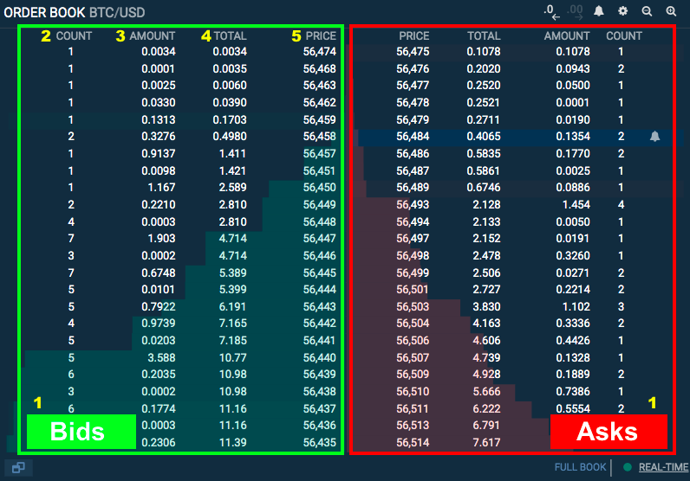
Who we are
Our realizations
Credit Card Fraud Detection
Index Tracking
Fraud
Replicate S&P 500 with ML technics
No Fraud
Analyze Transactions
Trip Advisor Rating Prediction
Trading
«««««
««««
«««
««
«
Build a trading order book
Analyze Language

Slide 4



How we can help you
Real Estate is nothing else than analyze data !
Seller
Real Estate Agent
Buyer
Don’t want to underestimate his house
Fullfill his client need
Don’t want to overpay a house
Every counterpart have a different target… but only one tool to achieve their goal :
Analyze Market Data !

Slide 5
How we can help you
… And analyze data is time consuming especially for real estate agent
1
Visit a house / neighborhood to collect information
2
Benchmarking with others houses
Real Estate Agent
3
Try to find the appropriate price considering all available data
Notes:
Faire interagir la classe avant de montrer les étapes ? ++ Bien appuyer sur l’idée que c’est un pb pour l’agent immo de devoir faire tout ca

Slide 6

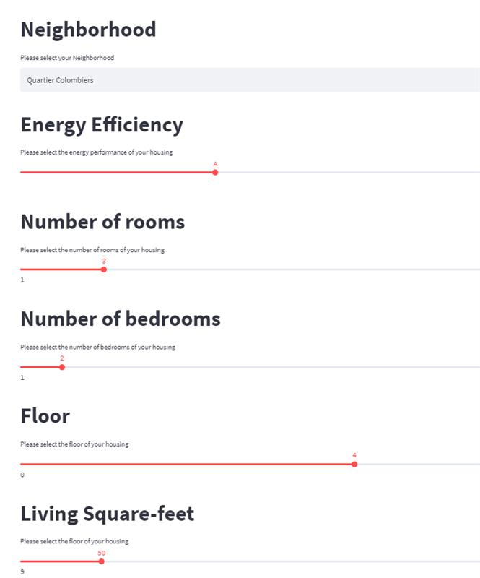
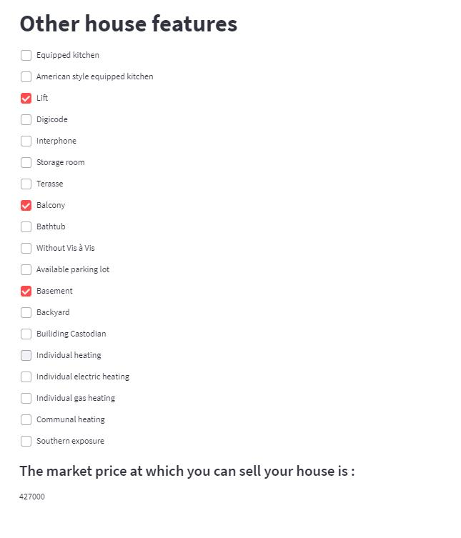
Our Solution
Estimate the best price without moving outside your agency !

Slide 7
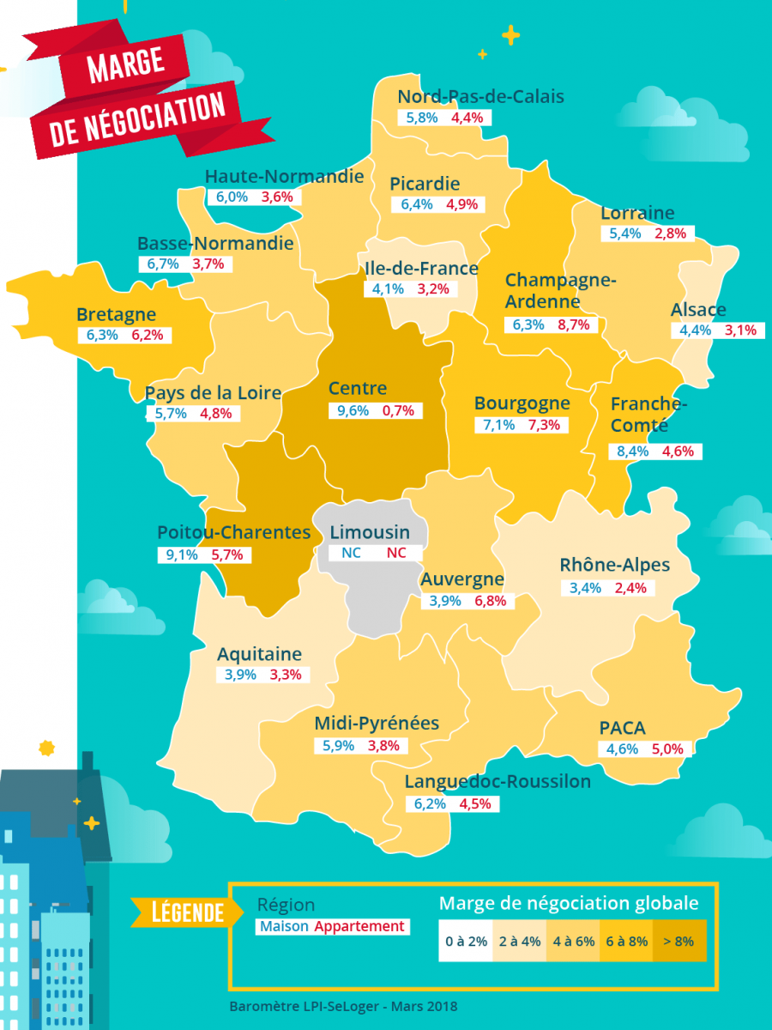
Why do you need our solution
Gain a competitive advantage
Have a non biased tool to price houses
Gain time on task with low added value
Focus more on client relationship
Limit the risk of discrepancies between the announce and effective selling price
Combine the agent expertise with the accuracy of the tool
Source : SeLoger.com. 2019

Slide 8


How we build our solution
Step 1 : Use a robot to recover all needed data from SeLoger.com
Hi ! I’m Blue prism !
Type
Price
m²
# Room
# Bedroom
Garden
Webscrapping
Parking
Lift
Etc.
Notes:
Transition : You are probably wondering how we are able to do so ?

Slide 9

How we build our solution
Step 1 : Example

Slide 10

How we build our solution
Step 1 : Example

Slide 11
How we build our solution
Step 2 : Process all data
Raw Data
Data Reprocessing
Output File Sample

Slide 12
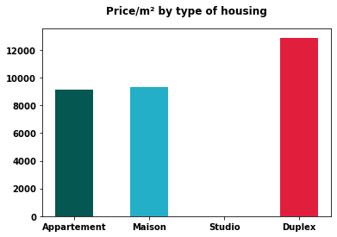
How we build our solution
Step 2 : Process all data – Key points to extract from data
To keep in mind :
Duplexes are the most expensive type of housing
Apartments & Houses are equivalent in terms of price
Notes:
Pour que la transition se fasse bien avec la slide d’avant bien préciser à l’oral : « before going through our ML model, let’s check what we can learn from the reprocessed data

Slide 13
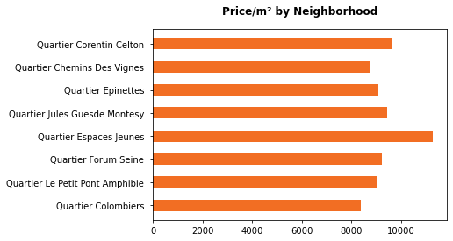
How we build our solution
Step 2 : Process all data – Key points to extract from data
To keep in mind :
“Espaces Jeunes” Neighborhood is more expensive than the other ones
“Colombiers” neighborhood is the cheaper in the city
Average
Notes:
Pour que la transition se fasse bien avec la slide d’avant bien préciser à l’oral : « before going through our ML model, let’s check what we can learn from the reprocessed data

Slide 14
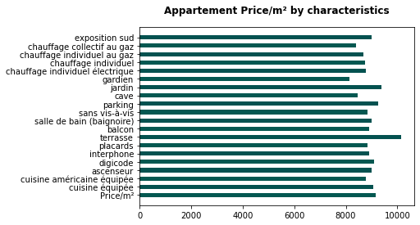
How we build our solution
Step 2 : Process all data – Key points to extract from data
To keep in mind :
Appartements with a Terrasse, a Garden and Parking lot are more expensive
Notes:
Pour que la transition se fasse bien avec la slide d’avant bien préciser à l’oral : « before going through our ML model, let’s check what we can learn from the reprocessed data

Slide 15
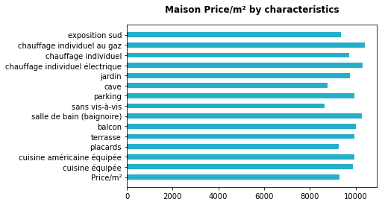
How we build our solution
Step 2 : Process all data – Key points to extract from data
To keep in mind :
For house, many features can explain a higher price
Notes:
Pour que la transition se fasse bien avec la slide d’avant bien préciser à l’oral : « before going through our ML model, let’s check what we can learn from the reprocessed data

Slide 16
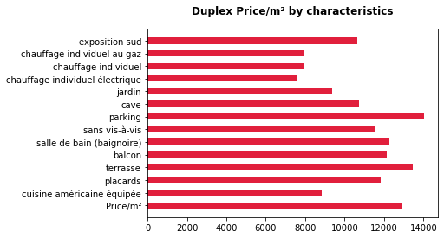
How we build our solution
Step 2 : Process all data – Key points to extract from data
To keep in mind :
Parking and Terasse are the most important factors that explain a higher price for Duplex type of house
Notes:
Pour que la transition se fasse bien avec la slide d’avant bien préciser à l’oral : « before going through our ML model, let’s check what we can learn from the reprocessed data

Slide 17
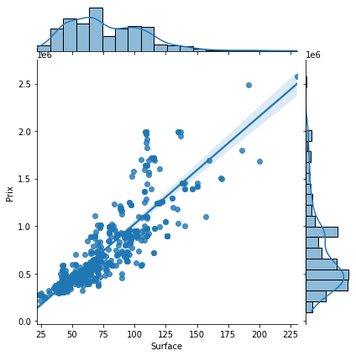
How we build our solution
Step 2 : Process all data – Key points to extract from data
Price & Living Square Feet
To keep in mind :
The more Living square feet you have, higher is the price
Notes:
Pour que la transition se fasse bien avec la slide d’avant bien préciser à l’oral : « before going through our ML model, let’s check what we can learn from the reprocessed data

Slide 18
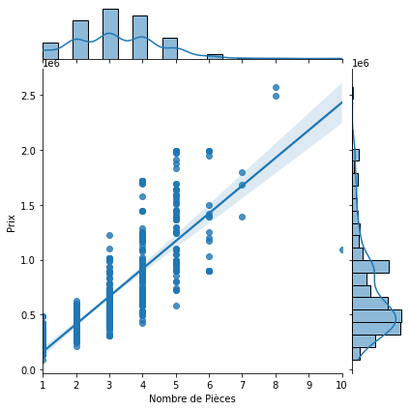
How we build our solution
Step 2 : Process all data – Key points to extract from data
Price & Number of Rooms
To keep in mind :
The more rooms you have, higher is the price
Notes:
Pour que la transition se fasse bien avec la slide d’avant bien préciser à l’oral : « before going through our ML model, let’s check what we can learn from the reprocessed data

Slide 19
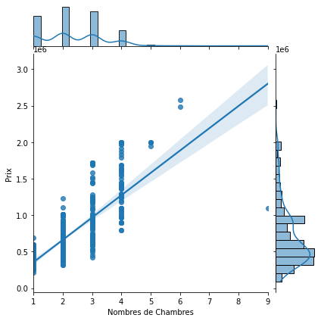
How we build our solution
Step 2 : Process all data – Key points to extract from data
Price & Number of Bedrooms
To keep in mind :
The more bedrooms you have, higher is the price
Notes:
Pour que la transition se fasse bien avec la slide d’avant bien préciser à l’oral : « before going through our ML model, let’s check what we can learn from the reprocessed data

Slide 20
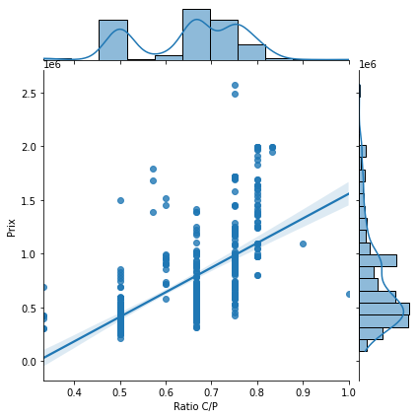
How we build our solution
Step 2 : Process all data – Key points to extract from data
Price & Ratio Bedroom / Rooms
To keep in mind :
The higher is the Bedroom/Room Ratio, higher is the price
Notes:
Pour que la transition se fasse bien avec la slide d’avant bien préciser à l’oral : « before going through our ML model, let’s check what we can learn from the reprocessed data

Slide 21
How we build our solution
Step 3 : Use reprocessed data to develop the Machine Learning Model
Regression
Linear Regression
Random Forest Regression
Gradient Boosting Regression
XGBRegressor
CatBoostRegressor

Slide 22
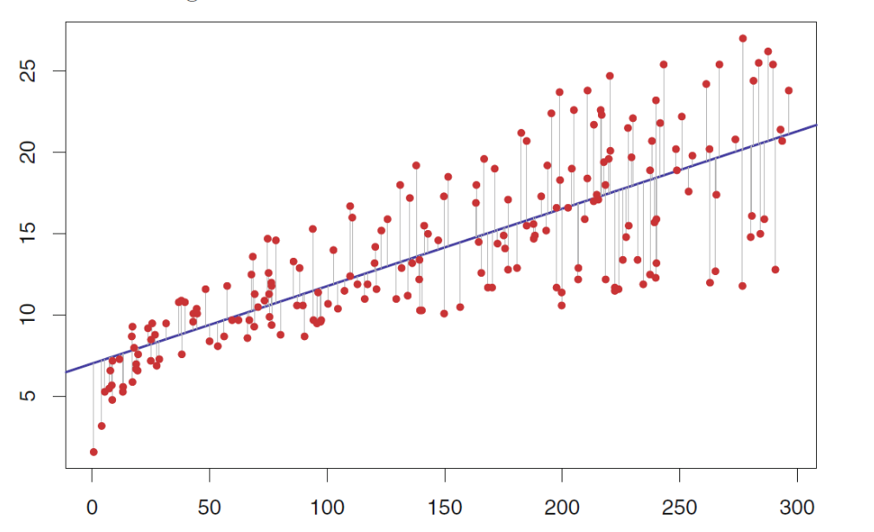


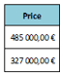
How we build our solution
Linear regression
Y
x1

Slide 23
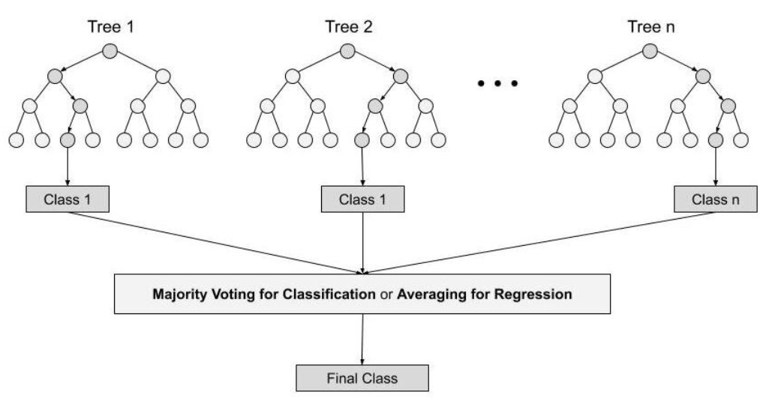
How we build our solution
Random Forest regression
Considering a random subset of features at each step

Slide 24
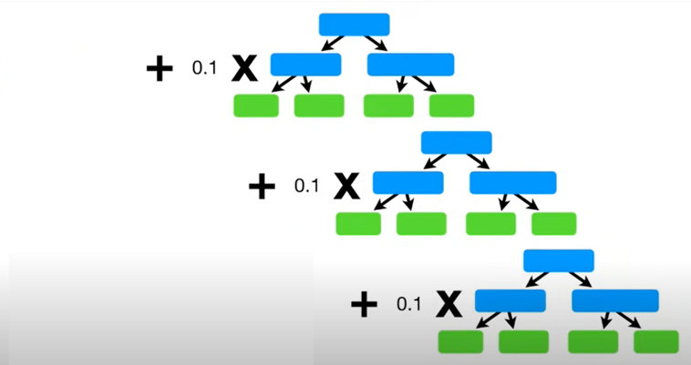

How we build our solution
Gradient boosting regression
Using decision trees to predict residuals
And a learning rate to avoid overfitting of the model
Average house price

Slide 25



How we build our solution
Gradient boosting regression
To get results and iterate quickly, and if dataset is relatively large
To get results and iterate quickly, and if dataset is relatively small and has several important categorical variables which we dont’t want to transform
To be able to bring a trustworthy popular model into production

Slide 26
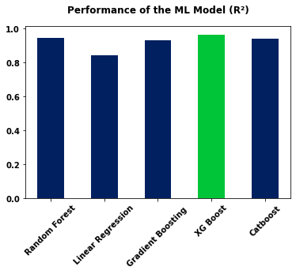
How our solution performs
Model Comparaison
Our performance metric
R²
Proportion of the variation in the dependent variable that is predictable from the independent variable
Notes:
Conclure en expliquant que notre solution est certes efficace mais qu’elle vient en appuie et en complément de l’expertise de l’agent immo (pour rassurer le business sur le fait que l’outil ne les remplacera pas mais les aidera plutôt)

Slide 27
Convinced ? Let’s do a demo !

